Slide 1
FINAL YEAR PROJECT 2026
UOS ADMISSION ASSISTANT
Intelligent University Voice Agent
An Urdu-speaking voice assistant for the University of Sargodha
Built on Retrieval-Augmented Generation (RAG)
TEAM
Muhammad Asmaad Saeed · Laiba Siraj · Fatima Zahid · Areeba Rehman
Advisor: Dr. Muhammad Saad Razzaq · Manager: Dr. Muhammad Ilyas

Slide 2
01 · THE PROBLEM
Why Did We Build UOS ASSISTANT?
200+
70%
15m
Daily inbound calls to UoS admissions office
Calls are repetitive: fees, eligibility, dates
Average wait time per caller, peaks at hour+
THE HUMAN COST
Staff burnout from repetitive question-answering, especially in admission season
Urdu-speaking callers from rural areas face English-only IVR systems — major accessibility gap
Zero availability outside office hours; calls go unanswered after 4pm and on holidays
Inconsistent responses across staff; misinformation propagates to applicants

Slide 3
02 · MARKET LANDSCAPE
What Solutions Already Exist?
AutoCalls.ai
No Urdu
Parloa
Cost
Generic call flow builder. English-first, no Urdu dialect support, rule-based not AI-driven.
Enterprise voice AI for customer service. Expensive licensing, not designed for academic institutions.
ElevenLabs Agents
No KB
Twilio Voice + Bots
DIY-heavy
High-quality voice generation but English-centric, generic agents, no university knowledge base.
Telephony + chatbots. Requires extensive custom development, no out-of-box Urdu STT/TTS.
Conclusion: No existing solution combines Urdu-first voice + university domain knowledge + RAG retrieval at low cost.

Slide 4
03 · R&D JOURNEY
First Approach: Modular Pipeline + KG
We initially designed a 4-module pipeline using a Knowledge Graph for structured retrieval:
01
02
03
04
ASR + STT
NLU
KG + GraphRAG
TTS
→
→
→
Google STT (Urdu)
Intent + Entity Detect
Neo4j + Cypher Traversal
Google TTS WaveNet
WHAT WE BUILT AND TESTED
Neo4j AuraDB · GraphRAG SDK
Ollama (qwen2.5, llama3.2) local LLMs
SentenceTransformers + Vector index
Cypher queries for graph traversal

Slide 5
04 · WHAT DIDN'T WORK
Limitations of the Modular Approach
✕
Entity Normalization Hell
✕
Brittle Cypher Queries
LLM extraction produced 8+ variants of 'BS Computer Science' — required manual node merging
Graph traversal returned irrelevant context when entities weren't extracted perfectly
✕
LLM Reasoning Failures
✕
Resource Heavy
Small open-source models (qwen 1.5b/3b) hallucinated and gave incoherent answers
Local LLMs needed 4-5GB RAM; cloud Neo4j had connection timeouts on free tier
✕
Complex Setup
✕
Limited Domain Coverage
Required Neo4j, vector index, multiple LLMs, embedders — too many moving parts
KG schema was rigid; couldn't easily ingest new document types or unstructured content

Slide 6
05 · THE PIVOT
New Approach: Clean RAG Architecture
We replaced the complex modular pipeline with a clean, production-grade RAG system:
STEP 1
STEP 2
STEP 3
STEP 4
STEP 5
Voice In
→
Embed Query
→
Vector Search
→
Generate Answer
→
Voice Out
Google STT
OpenAI text-embed-3-small
PostgreSQL + pgvector
OpenAI GPT-4o Mini
Google TTS
WHY THIS IS BETTER
✓
Production-grade LLMs (GPT-4o Mini) — reliable reasoning, no hallucinations
✓
Single vector DB — simpler infrastructure, faster queries, easier to maintain
✓
No entity normalization — pure semantic search handles all variations naturally
✓
Easy to extend — add new documents and the system learns automatically

Slide 7
PART
02
The User Interface
Android-native voice experience with Google STT & TTS
PRESENTED BY
Areeba Rehman

Slide 8

UI LAYER · OVERVIEW
UOS Assistant — Native Android App
PLATFORM
Android Native
UOS Assistant
Tap to speak
LANGUAGE
Java + Kotlin
MIN SDK
Android 7.0 (API 24)
VOICE INPUT
Google STT API
Response
"BS CS فیس..."
VOICE OUTPUT
Google TTS WaveNet
BACKEND CONNECT
REST API over HTTPS

Slide 9

UI LAYER · INPUT
Google Speech-to-Text Integration
How the STT Flow Works
1
Audio Capture
User taps mic — Android AudioRecord captures raw PCM audio at 16kHz mono
2
Streaming to Google
Audio chunks are streamed live to Google Cloud STT via gRPC for low latency
3
Urdu Recognition
Language code 'ur-PK' enables native Urdu transcription with Pakistani dialect
4
Code-Switch Handling
Multi-language config detects Urdu-English code-switching ('admission کب ہے')
5
Text to Backend
Final transcript sent to Agent Controller via HTTPS POST to /query endpoint

Slide 10

UI LAYER · OUTPUT
Google Text-to-Speech Integration
TTS PIPELINE
VOICE CONFIGURATION
1
Receive Response
ur-PK-Standard-A
JSON {response_text} from backend
Urdu Female (Standard)
2
Extract Speech Text
ur-PK-Wavenet-A
★
Parse response_text field
Urdu Female (WaveNet)
3
TTS API Call
en-US-Wavenet-F
POST to /v1/synthesize
English Female (WaveNet)
4
Audio Stream
Receive MP3/Opus audio
KEY PARAMETERS
5
Playback
Speaking Rate: 1.0 · Pitch: 0 · Format: MP3
Android MediaPlayer plays audio
Sample Rate: 24kHz · Channels: Mono
Latency: < 800ms typical end-to-end

Slide 11
PART
03
The Backend
Agent Controller, embeddings, vector search & GPT-4o Mini
PRESENTED BY
Laiba Siraj

Slide 12






BACKEND · OVERVIEW
Backend Architecture at a Glance
01
02
03
User Query
Agent Controller
Embedding
From UI (text)
FastAPI router
OpenAI text-embed-3-small
04
05
06
Vector Search
Prompt + Context
GPT-4o Mini
PostgreSQL pgvector
Structured input
Response generation
All hosted on a Linux server (Azure) · Containerized with Docker · Response sent back to UI

Slide 13
BACKEND · ORCHESTRATION
Agent Controller — The Brain
The Agent Controller is the central orchestrator. It receives the query, manages state, and coordinates every step:
RESPONSIBILITIES
API ENDPOINT
→
Receive transcribed text from the UI
POST 13.233.44.223/agent
→
Validate and sanitize the query input
Content-Type: application/json
→
Call OpenAI Embedding API
Request:
{
“android_id”: “user_alpha_123”,
“message”: “BS Computer Science ki fee kitni hai?”
}
→
Execute vector similarity search on PostgreSQL
→
Compose the LLM prompt with retrieved context
→
Call OpenAI GPT-4o Mini
Response:
→
Format and return JSON response
{
"response_text": “Undergraduate programs ka merit 40% Matric aur 60% Intermediate marks se calculate hota hai. Formula hai: [(Matric Obtained / Total) x 40] + [(Inter Obtained / Total) x 60].“
}
→
Log query, retrieval, and response for analytics

Slide 14
BACKEND · RETRIEVAL
Embeddings & Vector Search
STEP 1 · EMBEDDING THE QUERY
Input Text
OpenAI API
Vector Embedding
"BS CS fee?"
→
text-embedding-3-small
→
[0.024, -0.117, 0.891, ...]
1536 dimensions
STEP 2 · SIMILARITY SEARCH IN POSTGRESQL
SELECT user_message, ai_response_
FROM chat_history
WHERE android_id = ?
ORDER BY timestamp DESC
LIMIT 3;
PERFORMANCE
< 50ms
Average query time
Top-5 chunks returned
Cosine similarity index

Slide 15
BACKEND · GENERATION
GPT-4o Mini — Generating the Answer
The Agent Controller combines three inputs and sends them to GPT-4o Mini for the final response:
SYSTEM PROMPT
USER QUESTION
RETRIEVED CONTEXT
CHAT HISTORY
📋
💬
📚
📋
Defines persona, language preference (Urdu-first), response format and tone
The transcribed user query as received from the UI via Google STT
Top-K relevant chunks from PostgreSQL vector search containing UoS data
Saves chat history preferences from the last 3 messages from the user, Saves context.
↓
OpenAI GPT-4o Mini
temperature=0.2 · json response format
↓
Output: { "response_text": "...", "source": "RAG" }

Slide 16
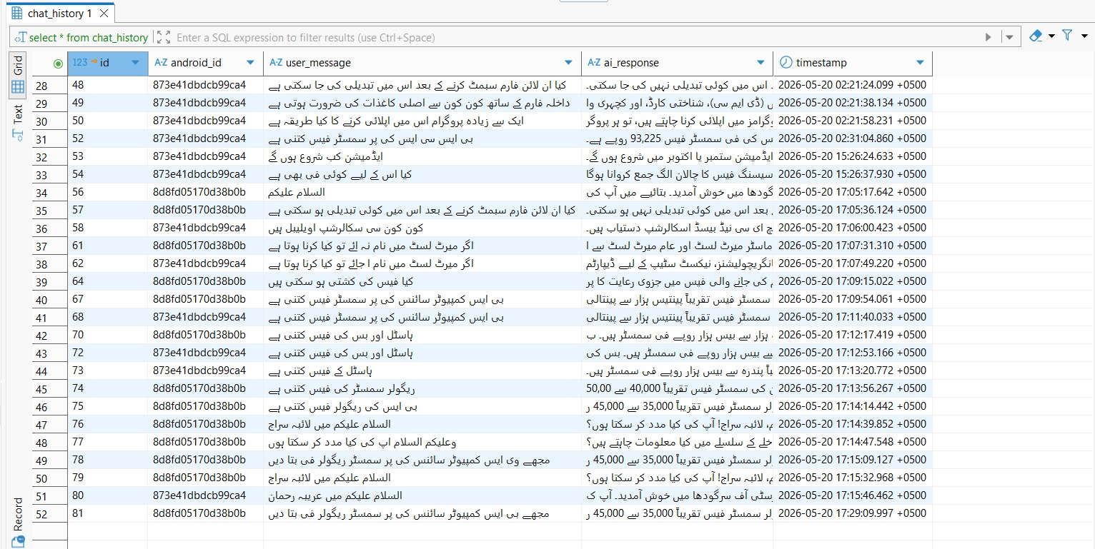
BACKEND · GENERATION
CHAT HISTORY TABLE

Slide 17




INFRASTRUCTURE
Server Setup & DevOps Tools
UniQuery runs on a Linux server hosted on Microsoft Azure, managed through these key tools:
PuTTY
FileZilla
SSH Client
FTP Client
Secure remote access to the Linux server for deployment, restarts and log monitoring
Upload university documents (PDFs/CSVs) and download log files between local machine and server
DBeaver
Docker
Database GUI
Containers
Inspect, query, and manage the PostgreSQL vector database — verify embeddings & data quality
Containerizes PostgreSQL + pgvector and backend services for consistent, isolated deployments

Slide 18
PART
04
Data, Infra & Future
RAG ingestion, server tools, benefits & roadmap ahead
PRESENTED BY
Fatima Zahid

Slide 19



DATA PIPELINE
Ingestion Utility— Documents to Vectors
A dedicated offline pipeline that processes university documents and stores them in the vector DB:
Source Files
→
Chunking
→
Embedding
→
Storage
PDFs · CSVs
Split docs into
500-char chunks
OpenAI generates
1536-dim vectors
Insert into Postgres
admission_document
TABLE SCHEMA
id
content
embedding
category
source_file
SERIAL
TEXT
vector(1536)
VARCHAR(50)
VARCHAR(255)

Slide 20
WHY IT WORKS
Benefits: New RAG vs Old Modular Approach
ASPECT
OLD MODULAR APPROACH
NEW RAG APPROACH
Architecture
✕
4 modules (STT/NLU/KG/TTS)
✓
Clean RAG pipeline
LLM
✕
Local Ollama (qwen 1.5b)
✓
OpenAI GPT-4o Mini
Knowledge
✕
Neo4j + entity normalization
✓
Pure semantic search
Resources
✕
~5GB RAM, multiple DBs
✓
Single Postgres DB
Accuracy
✕
Inconsistent (hallucination)
✓
Reliable, grounded
Setup Time
✕
Days (Neo4j, embedders, models)
✓
Hours (Docker + APIs)

Slide 21
ROADMAP
What's Next for UOS ASSISTANT
We have a clear roadmap to enhance UOS ASSISTANT beyond the current scope:
PHASE 1
Hybrid Retrieval: KG + Vector
Bring back Neo4j Knowledge Graph alongside the vector DB for multi-hop structured queries — best of both worlds for complex relational questions (e.g., 'show all programs with PKR 30k fee').
PHASE 2
Outbound Services
Proactive notifications to students for fee deadlines, exam schedules, and admission updates — extending UOS ASSISTANT from inbound only to a two-way assistant.
Multi-University Deployment
PHASE 3
Generalize the system to support multiple Pakistani universities with isolated knowledge bases — turn UOS ASSISTANT into a reusable platform.
Fine-tuned Urdu LLM
PHASE 4
Train or fine-tune an open Urdu LLM for better local language accuracy, reduce dependency on OpenAI APIs and lower per-call cost.

Slide 22
CONCLUSION
UOS ASSISTANT Delivers Real Impact
< 2s
Urdu
24/7
RAG
End-to-end response
Native voice support
Always available
Grounded answers
KEY TAKEAWAYS
✓
Iterative R&D — pivoted from complex modular KG to clean RAG when evidence demanded
✓
Production-grade stack — OpenAI + Google Cloud + PostgreSQL handles real-world load
✓
Urdu-first design — addresses a real accessibility gap for Pakistani university callers
✓
Extensible foundation — KG + GraphRAG hybrid planned as next evolution step

Slide 23
Thank You
Questions & Discussion
UOS ASSISTANT · Intelligent University Voice Agent · University of Sargodha
Muhammad Asmaad Saeed · Laiba Siraj · Fatima Zahid · Areeba Rehman

